Slide 1

DALCIDE Shelsy
Customer Churn Analysis
The BI-Project

Slide 2
Problem
Describe the business problem and define the analytic approach to solving the problem.
The company is losing customers at a very high rate, this problem is important for the company because they think that there is no possibility to expand with new customers
The stakeholders impacted by the problem are the compagny executive, the marketing team and the customer service team.
this problem is important to the organization because their customers churned then they lose a lot of profits.

Slide 3
Methodology
For the documentation we used the data provided by the company on 7000 customers, some of whom are churn.The variables chosen are those of the dataset which contains the following columns: Churn our independent variable and others that depend on it such as (ServicePhone,CustomerId,MonthlyCharge,Holding,TotalCharges,Gender,paymentMethod...) in order to make calculations to see some aspect about the current state of the company and its future.
The data analyzed is incomplete because we cannot specify the date that the customers left the company. Compared to the data we have:
Created a dataset that allowed us to
Do a Data Preprocessing
Exploration data analysis
Data manipulation

Slide 4
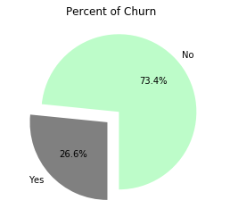
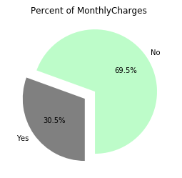
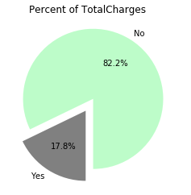
Results
The amount of churn customers is 26.5% and 73.5% are still our customers
.
The churn of the customer affect the business cause there's 17.8% of the company's revenue Total is lost
The Churn affect the compagny by a loss of 30.5% per Month.

Slide 5
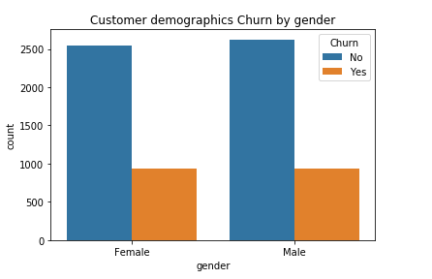
Results
The churn rate is more significant among women than men.

Slide 6
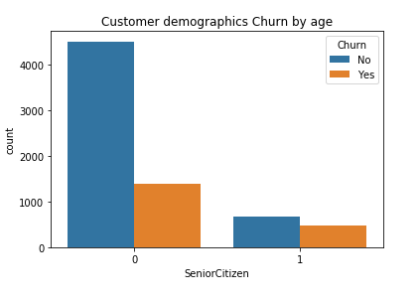
Results
There’s a lot of people who’s not Senior Citizen (age) and who’s churn more.

Slide 7
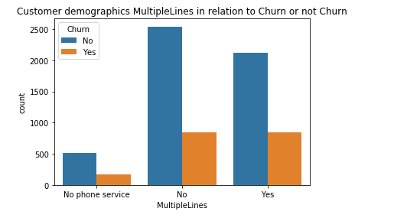
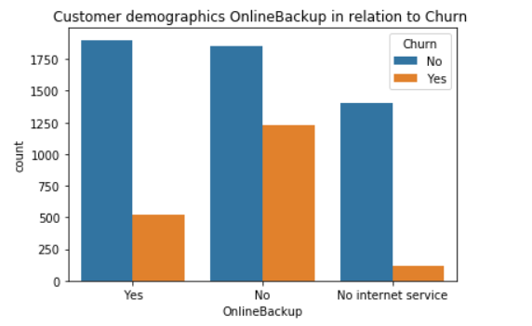
Results
The MultipLines and the BackupOnline is the service that the customers who don’t churn use more in the company that’s why we can use this service to make our customer who don’t churn loyalty.

Slide 8
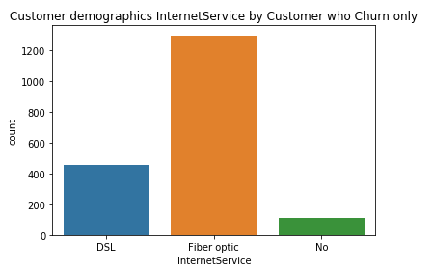
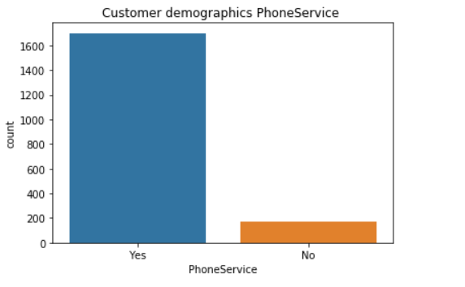
Results
The service more used by the customers who’s churn is the Fiber Internet Optic and the PhoneService

Slide 9
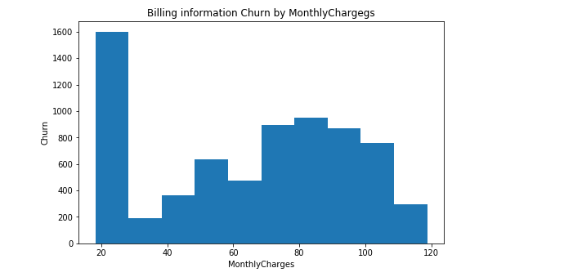
Results
Here we can see the rate that the company lose revenue per month
And we can see the monthly income of the comagny by Churn

Slide 10
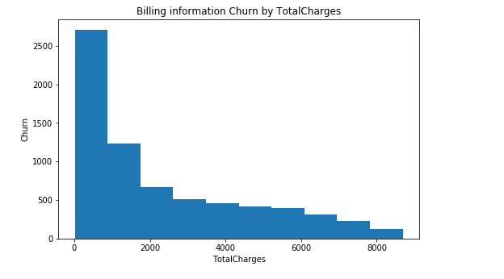
Results
Here there’s the rate the company lose profit in Totales

Slide 11
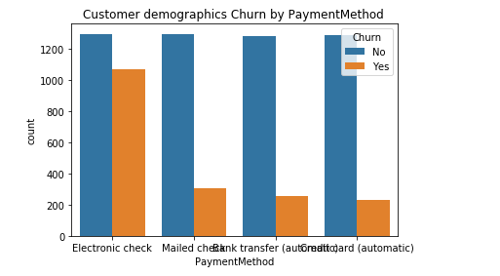
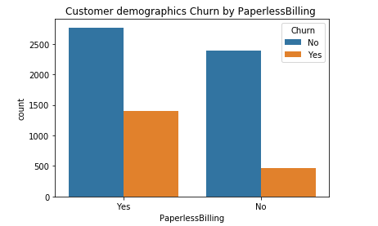
Results
Here all our Billing Information
The way each customer pay these service…

Slide 12
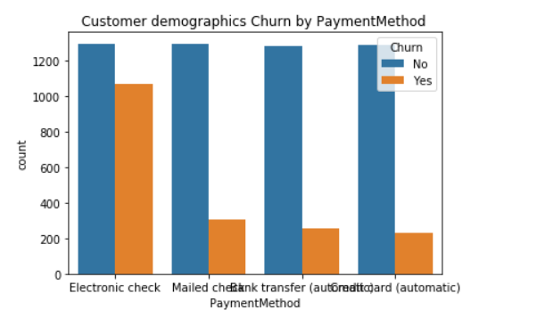
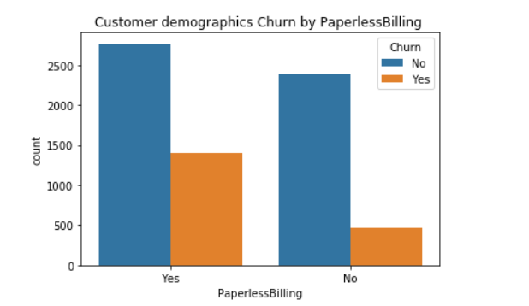
Results
In the Chart of method payment we can see that all the customers who churn were paying by Electronic Check
And these who used PaperlessBilling have churn a lot too.

Slide 13
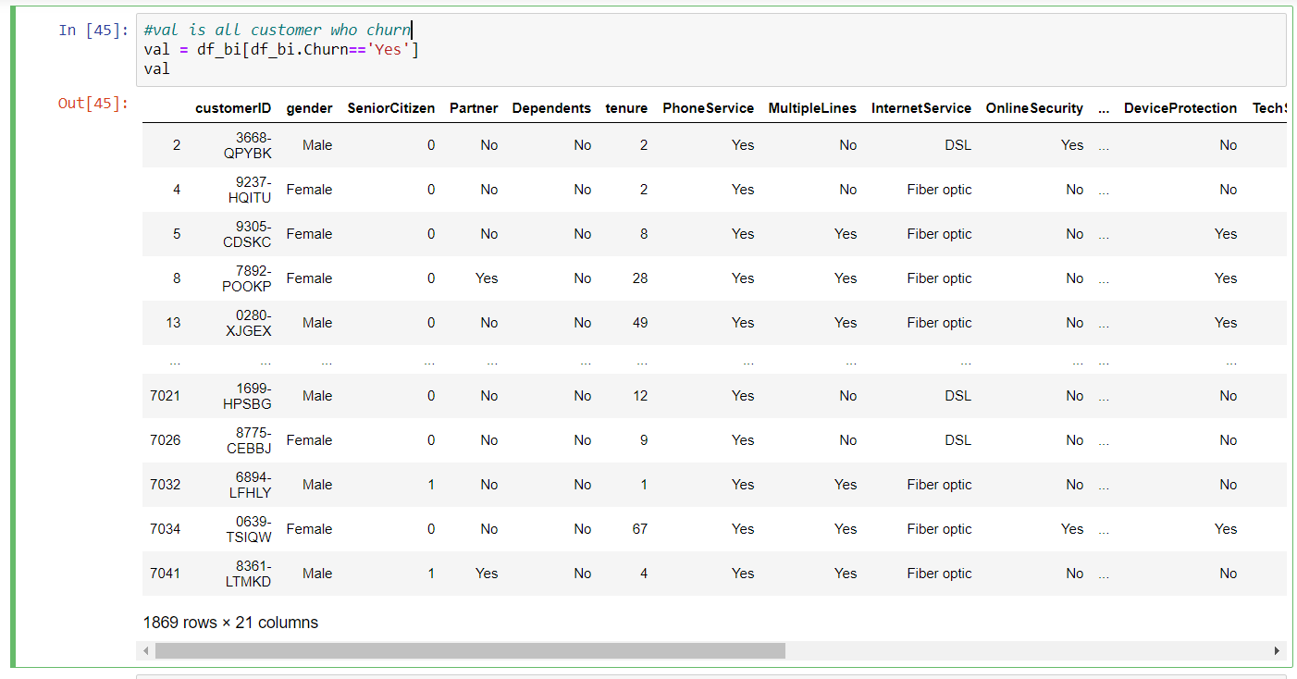
Results
This table show all Churn (Services, gender,SeniorCitizen…)
We will calculate how many men are churn and for women are churn too

Slide 14
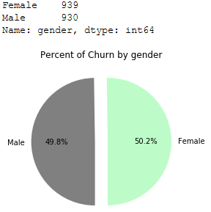
Results
This Chart shows the percent of women and men are churn
There’s more women churn than men

Slide 15
Results
Demographics clients who are not Dependents will only take five days to churn
The company will take about twenty-nine days to lose all those customers

Slide 16
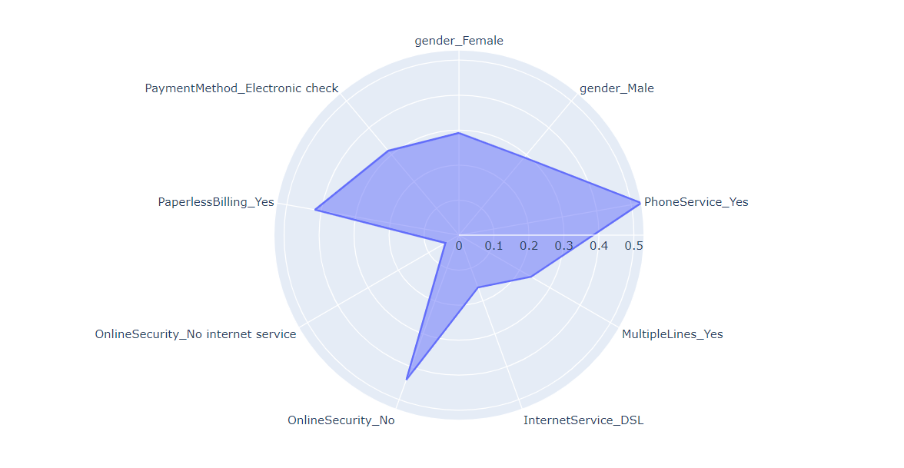
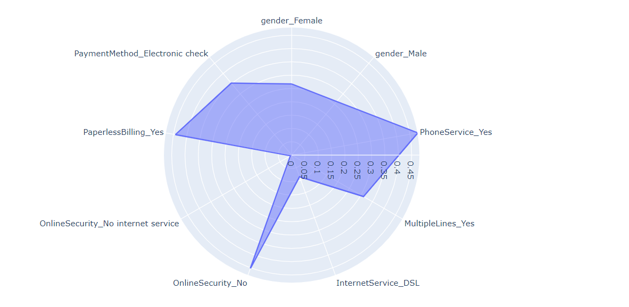
Results
Profile for women Adult
Profile for women major

Slide 17
Discussion & Recommendations
For the documentation we used the data provided
by the company on 7000 customers, some of whom are churn.The variables chosen are those of the dataset which contains the following columns: Churn our independent variable and others that depend on it such as (ServicePhone,CustomerId,MonthlyCharge,Holding,TotalCharges,Gender,paymentMethod...) in order to make calculations to see some aspect about the current state of the company and its future.

Slide 18
Discussion & Recommendations
What are strengths of the organization that you have leveraged in your solution?
The company has a certain renown in the market as it has been in existence for several years.
The company has a massive market share.
❏What are weaknesses of the organization that could undermine your solution?
It's difficult for the company to get new customers.
❏What are challenges that you might encounter? How can you mitigate them?
The customers can be a little reluctant despite we have proposed new services much more advantageous.
In this case we can generate within the marketing department to make advertising quite real and convincing

Slide 19
References & Appendices
Provide citations for your work and provide resources for your audience to learn more about the technical aspects of your project. Share links to your GitHub repository or accompanying spreadsheets.

